Slide 1
Museums of Washington, D.C.

Slide 2
Washington, D.C
Capital of the United States
City is known for its history
Hundreds of monuments and museums
Majority are free!

Slide 3
Project Overview
Goals:
Collect, clean, and analyze data on the museums of Washington, D.C.
Answer the following questions:
What are the highest rated museums?
What museums are located closest to where a tourist is staying?
Are there museum ‘hubs’ in the city?
Data:
Open source data from DC government
Foursquare API data

Slide 4
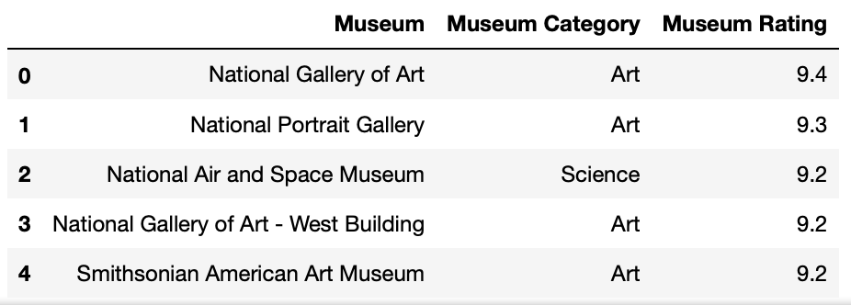
National Gallery of Art is the most popular museum in Washington, D.C.
Top rating is 9.4 out of 10.
Most popular museums are Art museums.

Slide 5
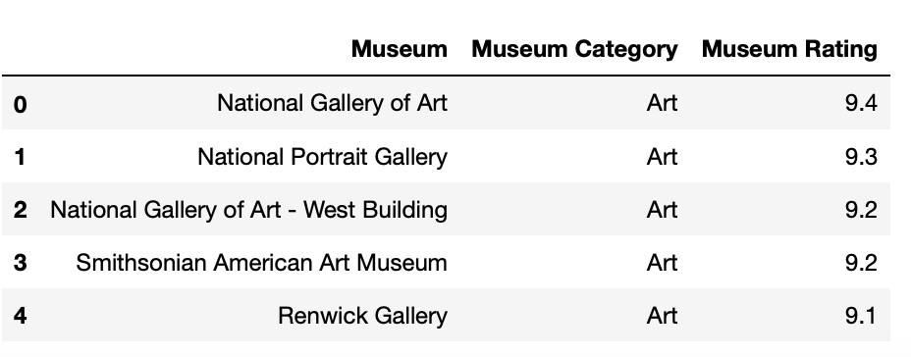
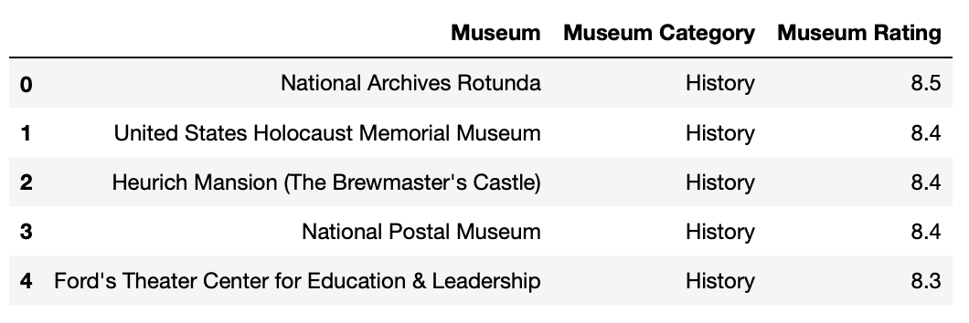
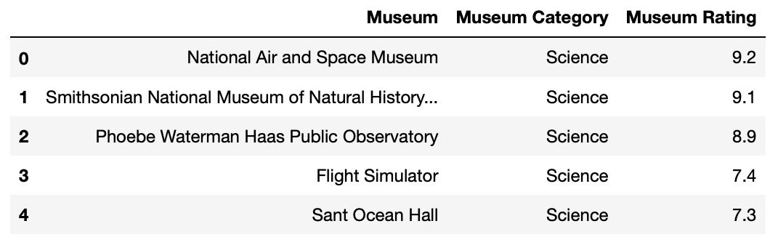
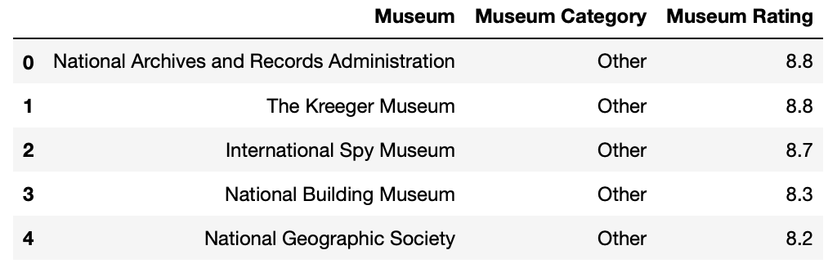
Rankings of museums arranged by category.
Top museums:
Art: National Gallery of Art
History: National Archives Rotunda
Science: National Air and Space Museum
Other: National Archives and Record Administration and The Kreeger Museum

Slide 6
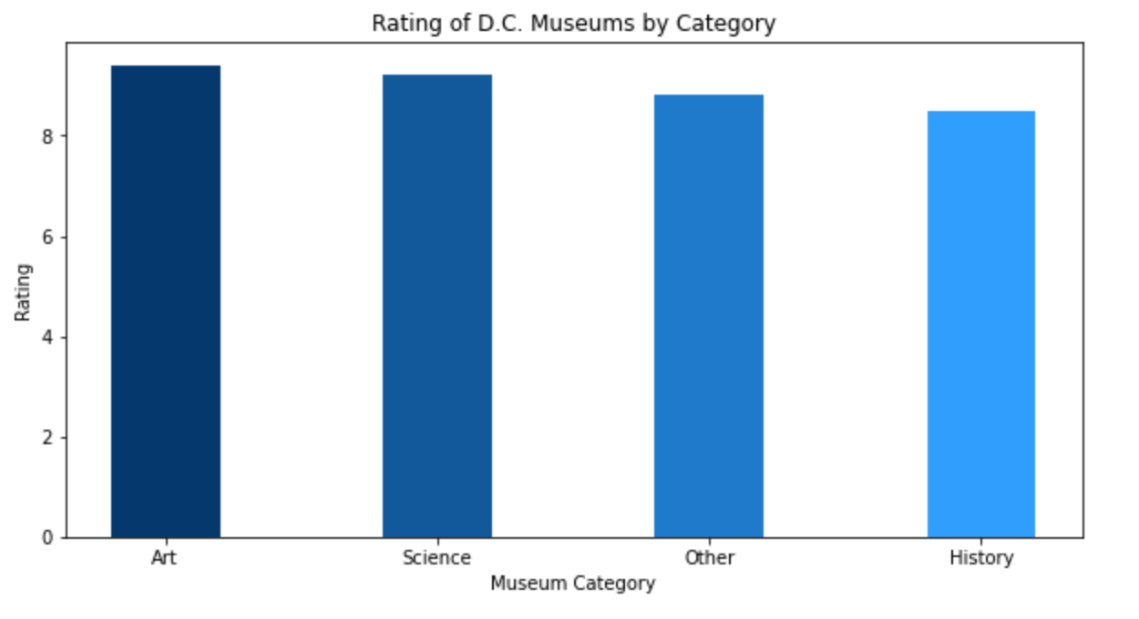
When comparing museum categories against each other, art museums (9.4) have the highest rankings. Followed by science (9.2), other (8.8), and history (8.5).
DC visitors should really check out the art museums!

Slide 7
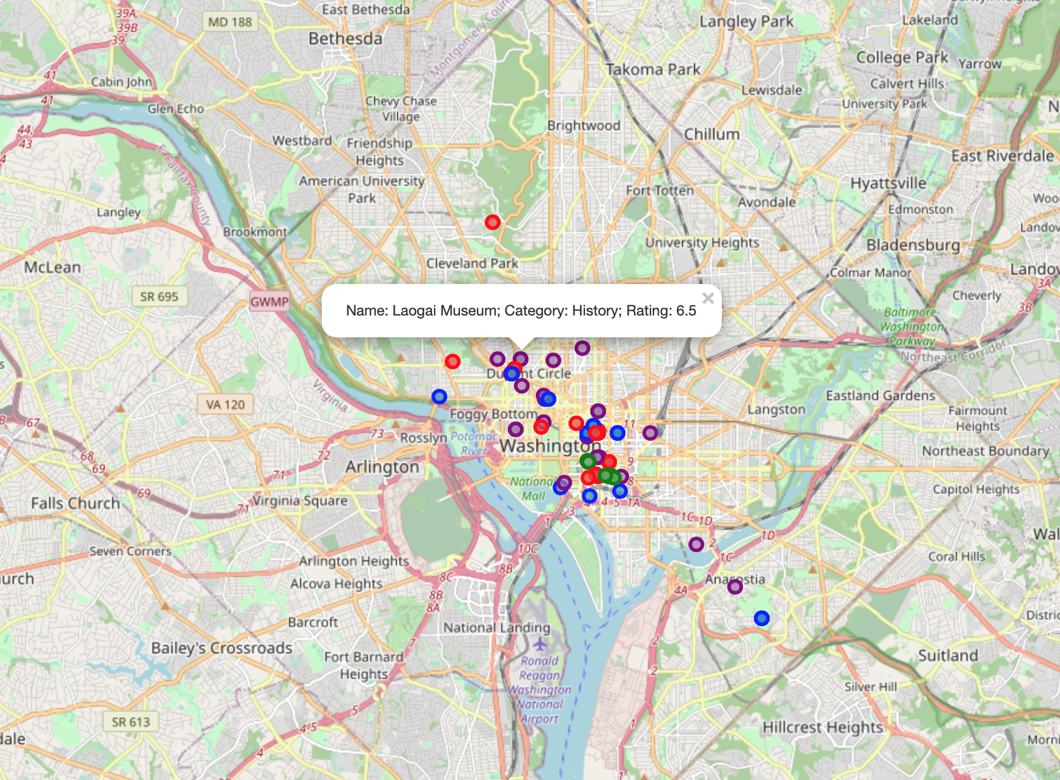
Map of the museums in D.C.
Categories can be distinguished by colors:
Purple: History
Green: Science
Red: Art
Blue: Other
Most museums are located in downtown Washington, D.C.
Science museum ‘hub’ in the Penn Quarter neighborhood.

Slide 8
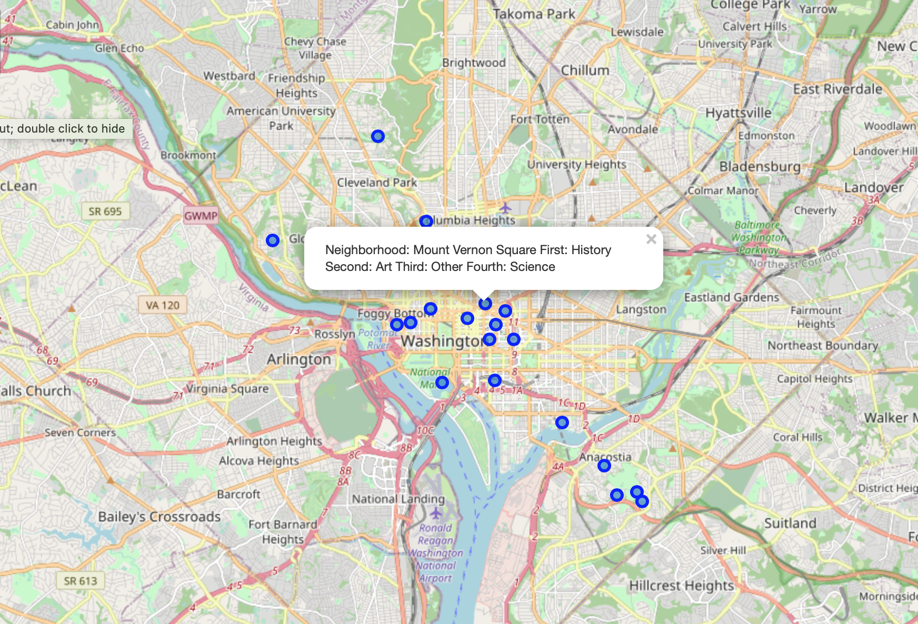
Map of neighborhoods in D.C.
Shows ranking of museum categories for each neighborhood.
Example:
Name: Mount Vernon Square
First: History
Second: Art
Third: Other
Fourth: Science
Not all neighborhoods have museums and so are not included in map.

